Slide 1


Employment Dynamics
Bay Area
Data^{X}
Team 10
Mariam Germanyan, Taline Mardirossian,
Aleksandra Ma, Riya Prahlad, Ayesha Yusuf
Mentor: James Hodson

Slide 2

Objective
Does obtaining a degree from UC Berkeley lead to better outcomes in the long run?
Notes:
Aleksandra

Slide 3



Dataset
Third Party Sources
LinkedIn, Indeed, etc.
Anonymous
Identification Removed
Bay Area
Current & Previous
Notes:
Aleksandra

Slide 4
Data Schema
ID: unique ID character
Birth year: where available, Default: 2001
Gender flag: 1=female, 2=male, 0=unknown
Skillset1: primary skillset deduced from self-reported skills
Skillset1 weight: the extent to which primary skillset is representative of overall self-reported skills
Skillset2: secondary skillset deduced from self-reported skills
Skillset2 weight: the extent to which secondary skillset is representative of overall self-reported skills
Education: (highest degree attained): 4=bachelor's; 5=master's other than MBA; 6=MBA; 7=doctorate (PhD/JD/MD)
Elite Institution: True=education record from an elite (top 100) institution; False=not education record from a non-elite institution
Start date: start date of the edu/employment record
Flag: Is the start month valid?
End date: end date of the edu/employment record
Flag: Is the end month valid?
Length: length of time spent at the given job (days)
Role: self-reported job role, followed by the normalized job title
Department: self-reported job role, followed by associated department
Company name: Company name if employment record,
School name if education record
Industry (NAICS): Industry Serial
Education flag: True = education record; False = employment record
Degree type: 0=unknown; 1=high school; 2=vocational degree; 3=associate's; 4=bachelor's; 5=master's other than MBA; 6=MBA; 7=doctorate (PhD/JD/MD);
Notes:
Aleksandra

Slide 5



Filtered Data:
berk_edu:
table with rows of all education levels for people who obtained at least one degree from UC Berkeley
non_berk_edu:
table with rows of edu levels for people who did NOT obtain any degree from UC Berkeley
tech_berk:
table of all jobs that Berkeley graduates got in the tech field
tech_non_berk:
table of all jobs in tech industry for non-Berkeley-graduates
Notes:
Aleksandra

Slide 6
Approaches
Promotions
Measure how Berkeley graduates do versus graduates from other schools by the number of promotions they get in their career
Nearest Neighbor Matching
Match a Berkeley-graduate Bay Area worker in tech with the most similar non-Berkeley graduate Bay Area worker in tech
Objective
Prediction
Predict the time between graduation and first job in tech based on degree type and skillset weight.
Notes:
Ayesha
Predicting the amount of time it will take a person to find a job after graduation depending on the level of degree they are obtaining, and their self-identified skillset.
Analysis:
Comparing the duration of Berkeley students from non-Berkeley students
Compare how obtaining a degree from UC Berkeley has an effect on one’s future.
Measure the value of a degree from Berkeley

Slide 7
First Steps
Data Cleaning
EDA
Noisy Data + Cleaning Features
Different Subsets of Data
Sometimes good features that we want to do analysis on are noisy
Ex. Didn’t want education data when looking at jobs, filtered job titles that had keywords related to tech
Berkeley grads vs Non-Berkeley grads (ex. Grads from Stanford, UC Davis, etc.)
Male Workers vs Female Workers
Different Degree Types
Notes:
Ayesha
-a lot of default values, didnt want employment data when looking at tech, places where job title had certain key words related to tech, extracted ids of those educated in berk, filtered out those ids for people in jobs

Slide 8
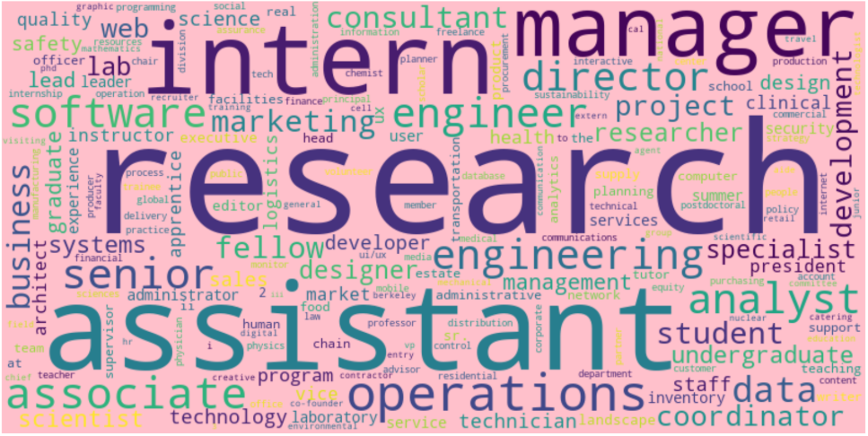
Word Cloud for Berkeley-Grad Females in Tech
Notes:
Mariam
We built word clouds by counting keywords in the job title columns (after removing stop words). So, in the following visualizations we see the most common keywords in their job title, the bigger the word, the more frequency that word had.
From this visualization, we see that Berkeley-Grad females in tech emphasized
Research, assistant, intern, manager, associate, operations, software, engineer, analyst and so on

Slide 9
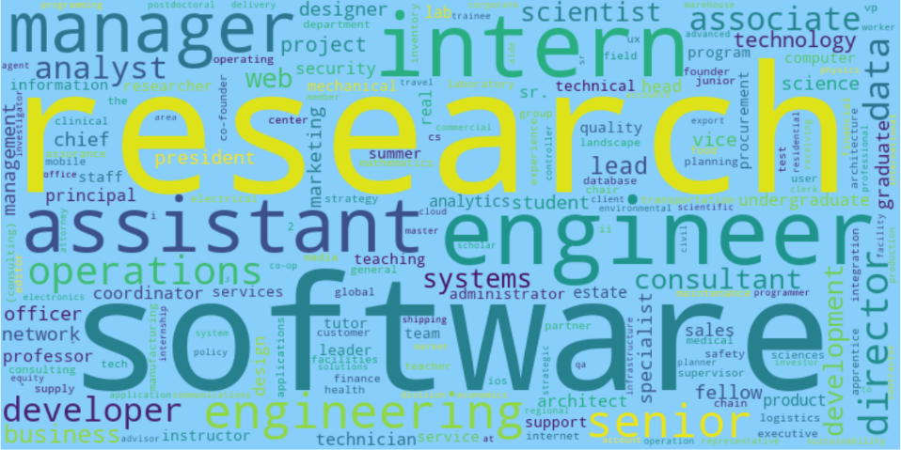
Word Cloud for Berkeley-Grad Males in Tech
Notes:
Mariam
From this visualization, we see that Berkeley-Grad males in tech emphasized:
Research, software, intern, engineer, assistant, manager, engineering, senior, and so on

Slide 10
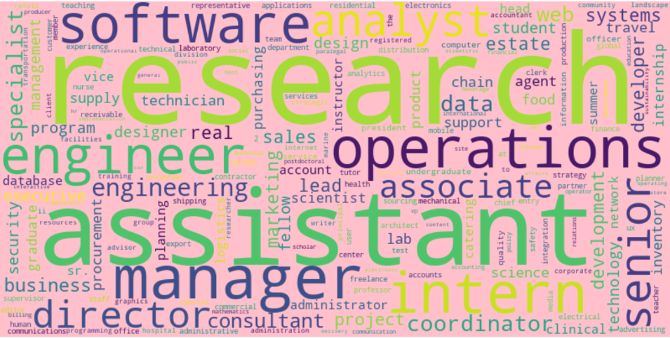
Word Cloud for Non-Berkeley-Grad Females in Tech
Notes:
Mariam
From this visualization, we see that Non- Berkeley-Grad females in tech emphasized:
Research, assistant, manager, intern, software, engineer, director, analyst, and so on

Slide 11
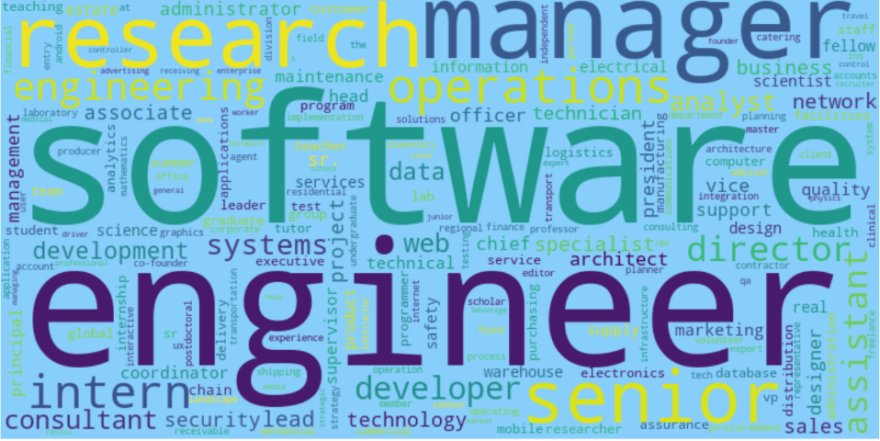
Word Cloud for Non-Berkeley-Grad Males in Tech
Notes:
Mariam
From this visualization, we see that Non-Berkeley-Grad females in tech emphasized
software, engineer, manager, research, senior, operations, intern, engineering and so on

Slide 12



Main Takeaway from Word Clouds
Male
Female
Berkeley
Non-Berkeley
More emphasis on software roles
More emphasis on assistant roles
Research stands out more
More Internship positions
More manager positions
Disclaimer: Different lengths of each in the datasets:
Berkeley females: 3345 records
Berkeley males: 5762 records
Non-Berkeley females: 2466 records
Non-Berkeley males: 5622 records
Notes:
Mariam
More manager positions - take in consideration that its Berkeley everyone else so we are still contineu

Slide 13
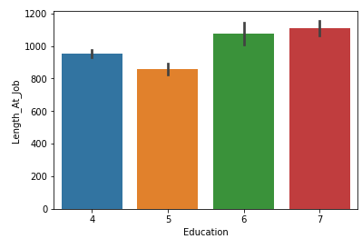
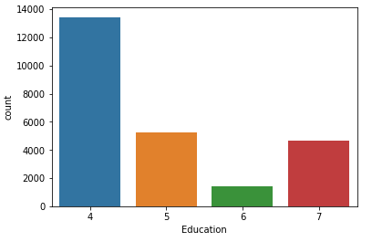
Education Analysis for Tech
Relative average length at tech job* for highest education achieved
Count of highest education achieved
4: bachelor 5: masters 6: mba 7: doctorate
* Jobs in tech are defined through certain filters on department, industry, and job title
Notes:
Mariam
Here we see that people with higher education are more stable in their job where the length at job increases as their degree does.
But with the figure on the right we got a row for each candidate and plotted their highest_education obtained, we see that an abundance of the data is consists of people that stopped at bachelors. And people that continue to get their masters and doctorate are relatively the same.

Slide 14
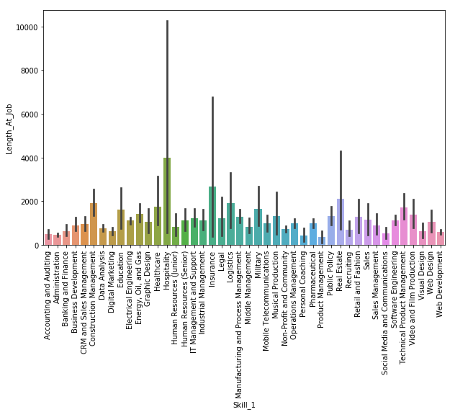
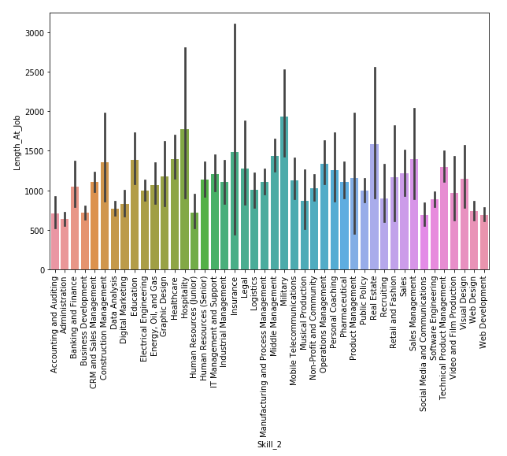
Skills vs. Job Length for People in Tech
Notes:
Taline
We can see the relative lengths for the 44 unique skills

Slide 15
Procedures for Nearest Neighbor Matching Model
For each person in the Berkeley Tech dataset, we “scored” everyone in the Non-Berkeley Tech dataset based on their similarities based on:
Skills and Skill Weights *
Degree Type (Bachelors vs. MBA vs. PhD) *
Elite University
Major
Each Berkeley-Tech person was matched with the most similar Non-Berkeley Tech person, using samples of each dataset.
* These features were weighted more heavily in determining scores.
Notes:
Riya

Slide 16
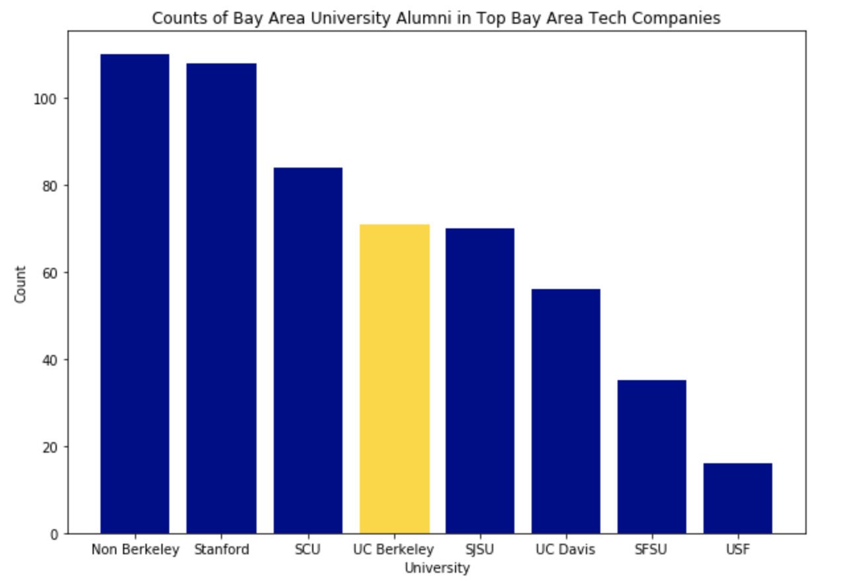
Using the Nearest Neighbor Approach
Notes:
Riya *Elaborate*
Using Propensity Score Matching on the UC Berkeley Students and calculating the amount of people that work/worked in the Top Bay Area Tech Companies from those thats are matched.

Slide 17
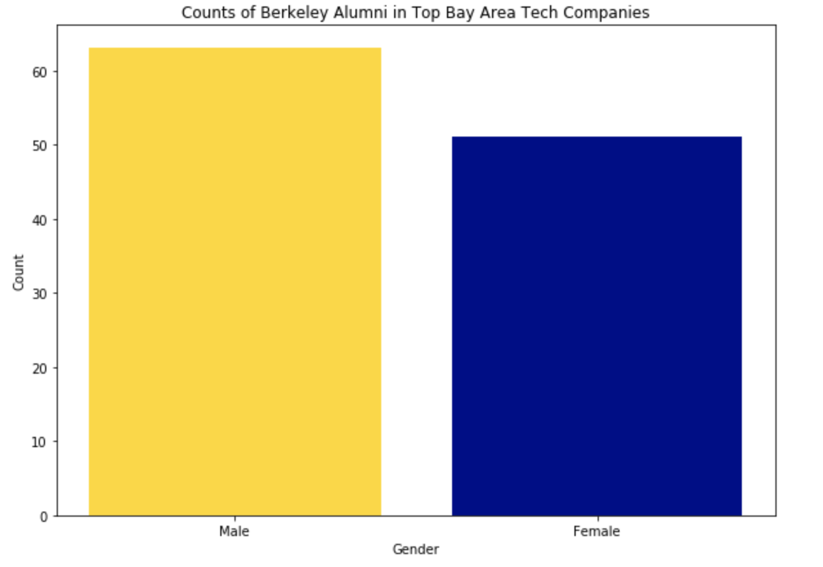
Relation between lengths at jobs for UC Berkeley graduates split on gender
Counts of Berkeley Male & Female Alumni in Top Tech Companies
Notes:
Riya

Slide 18
Process for Determining Promotions
Using the Berkeley Tech dataset and generating tech datasets for other schools:
For each unique ID, count the total number of companies one has worked for
Count the number of unique companies within total number of companies
Subtract number of unique companies from the total number of companies to get number of promotions
*Promotion = if someone has the same company listed multiple times in their job history, we assume they moved positions in an upward direction
Notes:
Ayesha

Slide 19
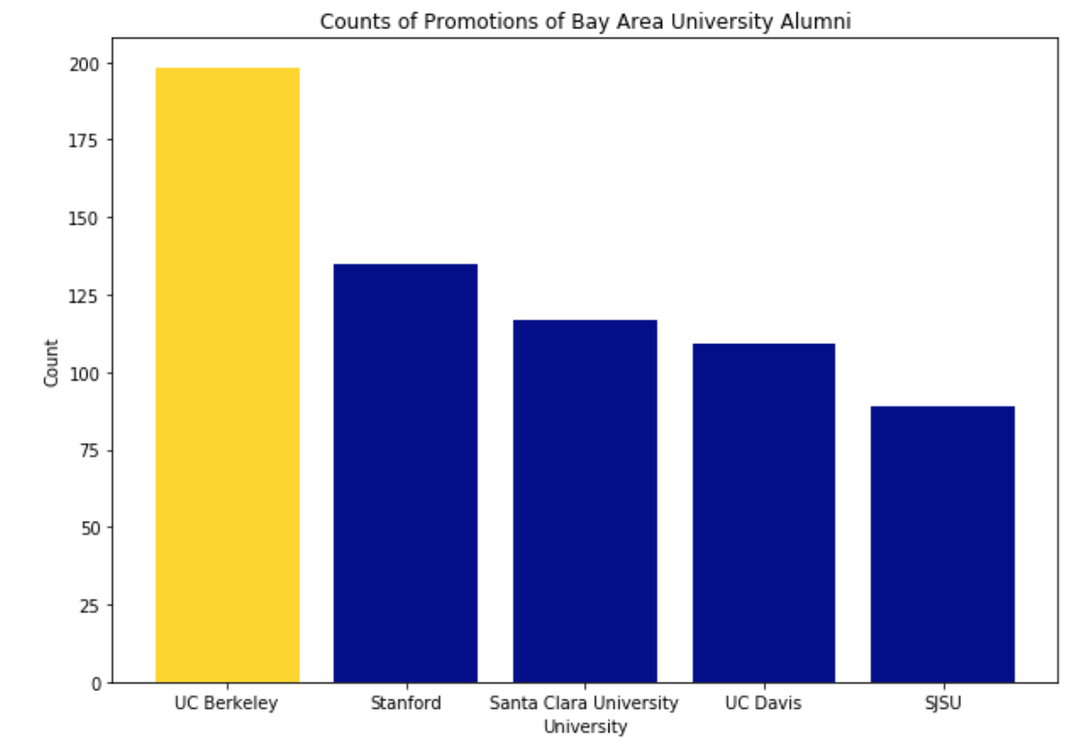
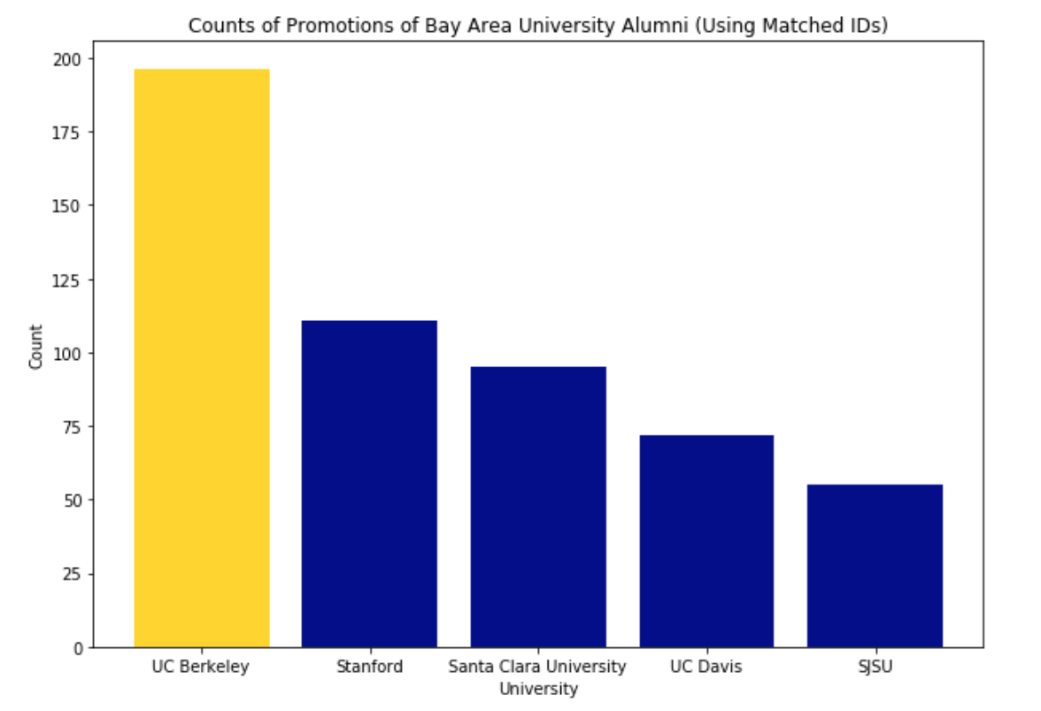
Non-Matched vs. Matched Promotions
Notes:
Ayesha

Slide 20
Procedures for Predicting Time Between Last Education and First Tech Job (Post Grad)
Test, Validation, and Train Split on the Data
Separate between Berkeley and Non-Berkeley students into two tables: an education table and a job experience table (total four subtables).
Extract the end date of the last education record and the start date of the first job in tech* after the last date of education in order to compute the duration of commiting to a job after graduating.
Build a linear regression model to predict how long it will take to find a job given what type of degree you are obtaining and the self-identifying skills weights
Notes:
Taline

Slide 21





Architecture of Predicting Duration
Linear Regression Model
X: Degree Level
Self-reported Skills
Y: Time taken before finding the first job and completing the latest degree
5
---
Minimize the loss function
4
---
Find MAE on the predictions with the actual
3
---
Obtain the actuals for the validation set
2
---
Predict durations for the validation set of data
1
---
Fit a linear regression model on training data
Notes:
Taline

Slide 22
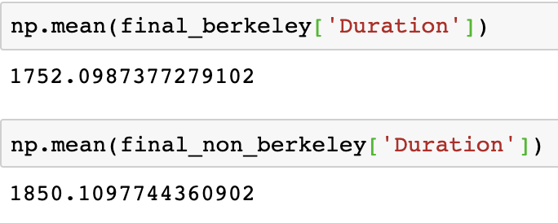
Comparing Berkeley vs. Non-Berkeley duration between last education and first tech job
Taking the averages of our calculations for duration, we found that on average, people with a degree from Berkeley find jobs in relevant fields within the Bay Area faster than those not graduating from Berkeley.

Slide 23
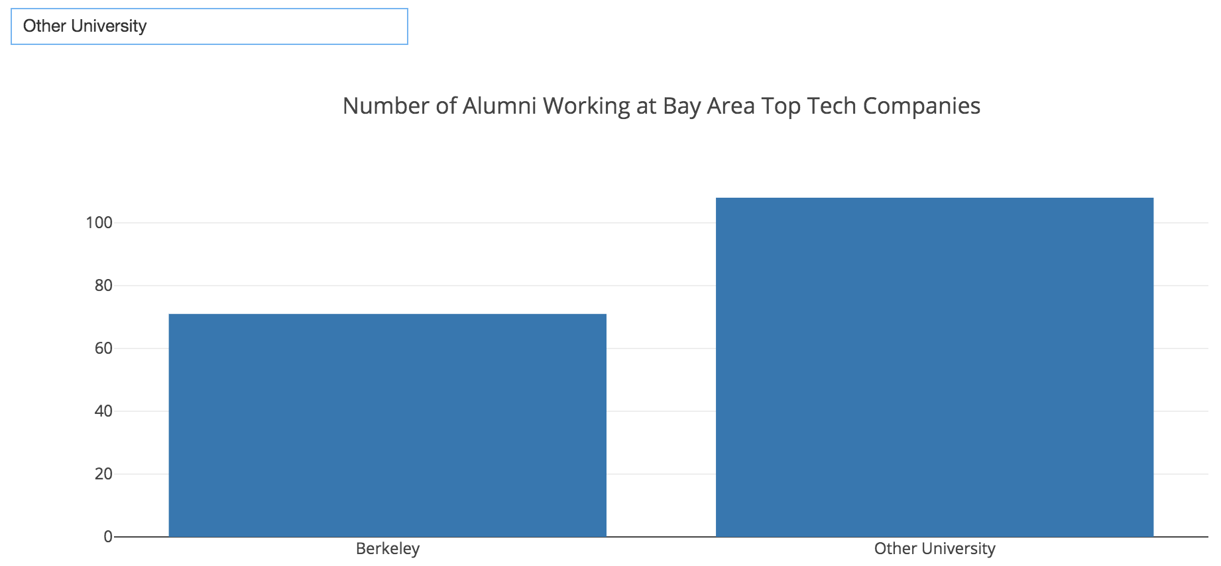
Intended User Interface
JUPYTER WIDGETS USER INTERFACE
Load in the manipulated data from CSVs.
Interactive widgets for the User to see the different visualizations for features.
Notes:
Riya

Slide 24
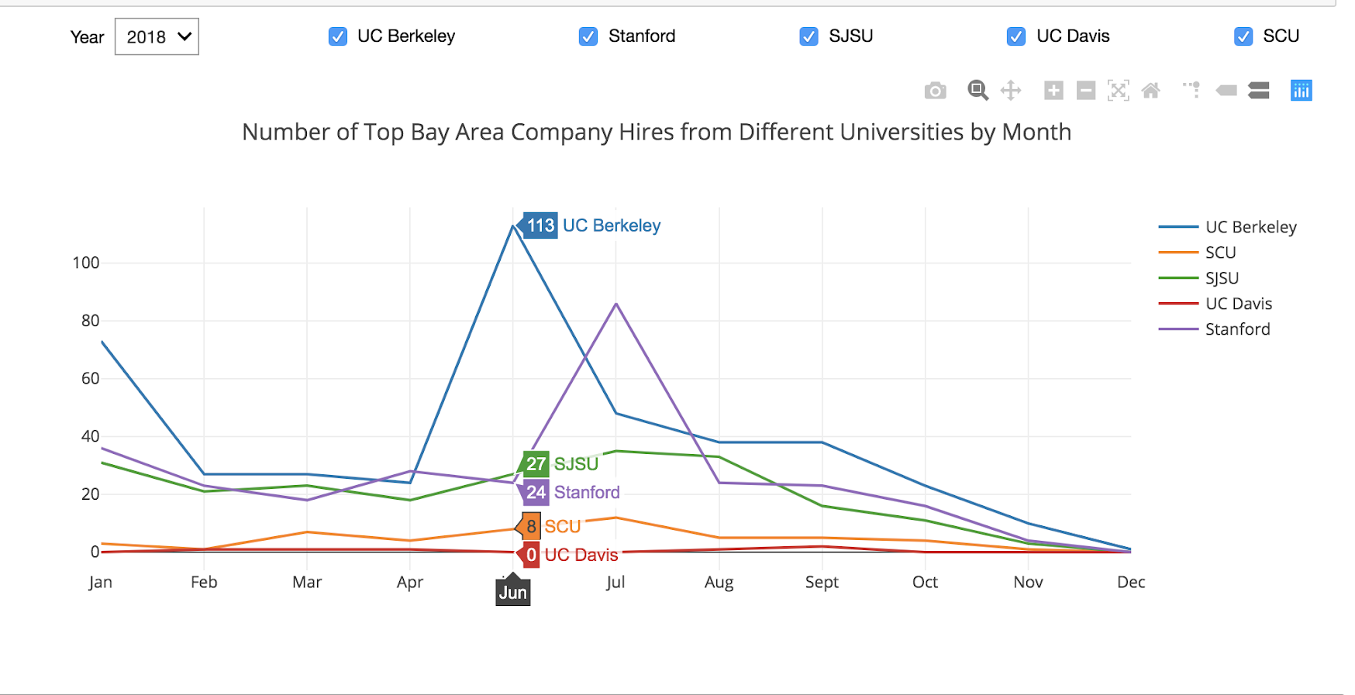
Intended User Interface
JUPYTER WIDGETS USER INTERFACE
User able to select different Universities and Year to compare statistics on
Notes:
Riya

Slide 25
Learning Path
Logic of Implementation
4
Closely working with our mentor
Constantly improving our logic
Having multiple iterations of our code
Real World Data
3
Can be messy
Needs lots of cleaning
In-depth understanding of what columns represent/how each can be beneficial for analysis
2
Optimization
We had a lot of data, and functions took hours to finish. In order to optimize our time, we tested our functions on samples to test our code.
In terms of fitting regression line: find features which lead to best results
1
Difficulties
Attempted to work with quantitative data: proved difficult to fully amend broken values
Notes:
Our learning path started when we received the real world data and we realized how messy data can be, along with the importance of cleaning your data and understanding the data schema. After understanding the data, we had difficulty working with quantitative data because the logic was broken and it was difficult to fix these attributes. Working closely with our mentor was a good learning experience in that we were constantly improving our logic and updating multiple iterations of our code. Considering the amount of data we had, in order to optimize our time, we tested our functions on this sample prior to testing it to the whole data set.

Slide 26
Potential Areas to Improve On
Additional factors to take into account:
*Matching algorithm doesn’t consider age
Predicting Duration: First tech job doesn’t occur until ~1972
*Promotions: Assuming multiple jobs at same company = promotion (for a single person)
*User Input: Hard to consider multiple names of single university
Need to incorporate more quantitative features in Regression Model
*Skills are self-reported
Do specific analysis comparing UC Berkeley and another Bay Area University for duration analysis
Notes:
Riya

Slide 27
Does obtaining a degree from UC Berkeley lead to better outcomes in the long run?
Notes:
Ayesha

Slide 28



Conclusion
It seems that it isn’t necessarily easier or harder for UC Berkeley grads to get into top companies.
Berkeley grads achieve more promotions within their companies!
Berkeley grads find jobs in the Bay Area 6% faster than other graduates.
Notes:
Ayesha

Slide 29
Thank You!
Link to GitHub repo : https://github.com/rprahlad1/ai4good

